Slide 1
THE 2048 GAME

Slide 2
ABSTRACT
-2048 is a game which is very well known by everyone. When you press the enter key , you will be entered into the game.
-There you will see all the keys and the numbers.
-Your score will be displayed on the right side.
-With the help of the keys on your keyboard you can play the game
-There are left, right, upward, and downward keys that you will be needing with the help of that you can select the blocks as you wish.
-After all the blocks are filled you automatically be out of the game.
-If your score is 2048 then that means that you have won the game

Slide 3
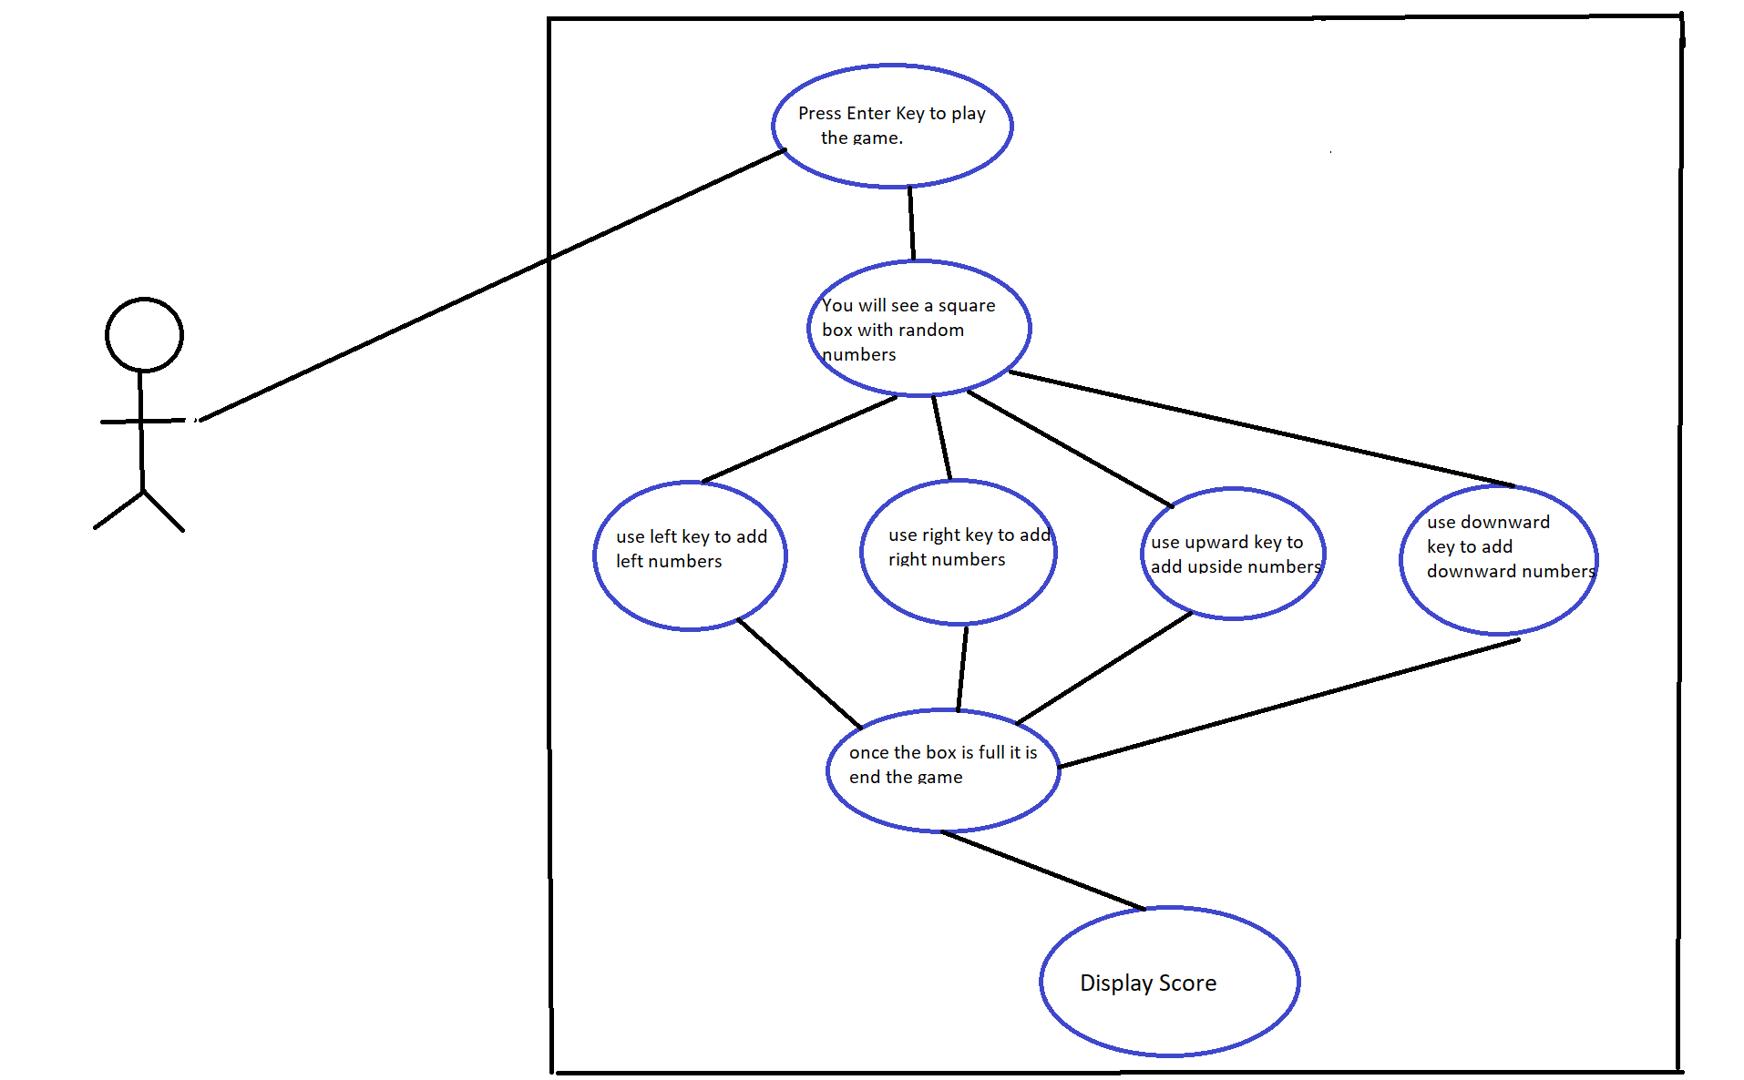
USE CASE DIAGRAM

Slide 4
Technology used
SOFTWARE REQUIREMENTS
Software Requirements deal with defining the software resource requirements and prerequisites that need to be installed on a computer to provide optimal functioning of an application. These preconditions are generally not included in the software installation package and need to be installed separately.
In order to use 2048 GAME , one should have the following:
⦁ Operating System: Windows 7 and above
⦁ C Compiler: GCC compiler
⦁ Editor: Any text editor (preferably VIM)
HARDWARE REQUIREMENTS
Hardware requirements refer to the common set requirements defined by any operating system or software application and are usually the physical computer resources. In this, we look into the architecture, processing power, memory, secondary memory, display adapter and peripherals.
In order to use 2048 GAME, one should have the following:
⦁ Processor: Intel Core i5 and above
⦁ Memory: 4 GB RAM and above

Slide 5
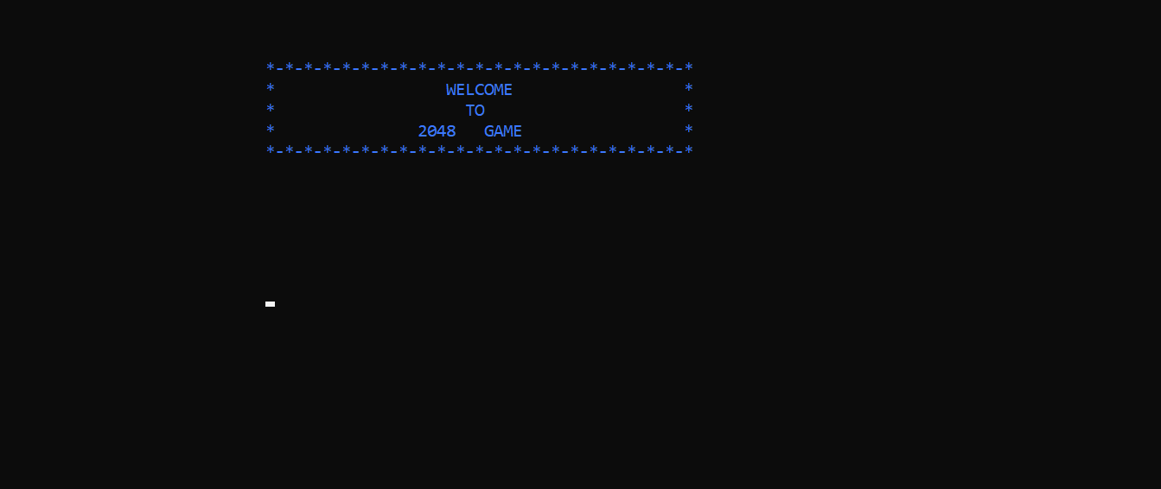
results

Slide 6
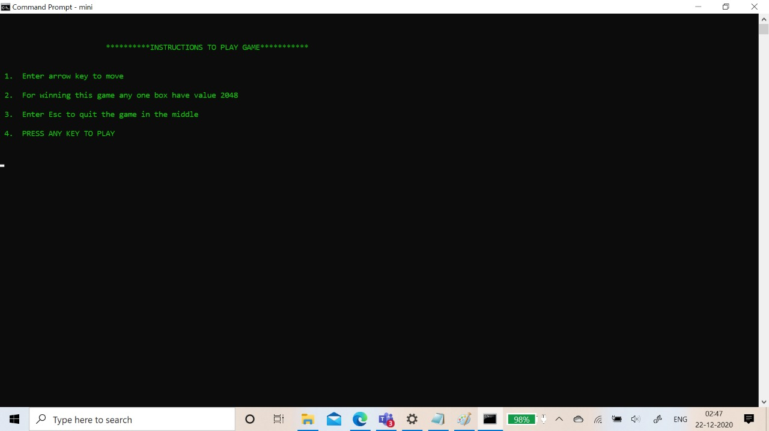

Slide 7
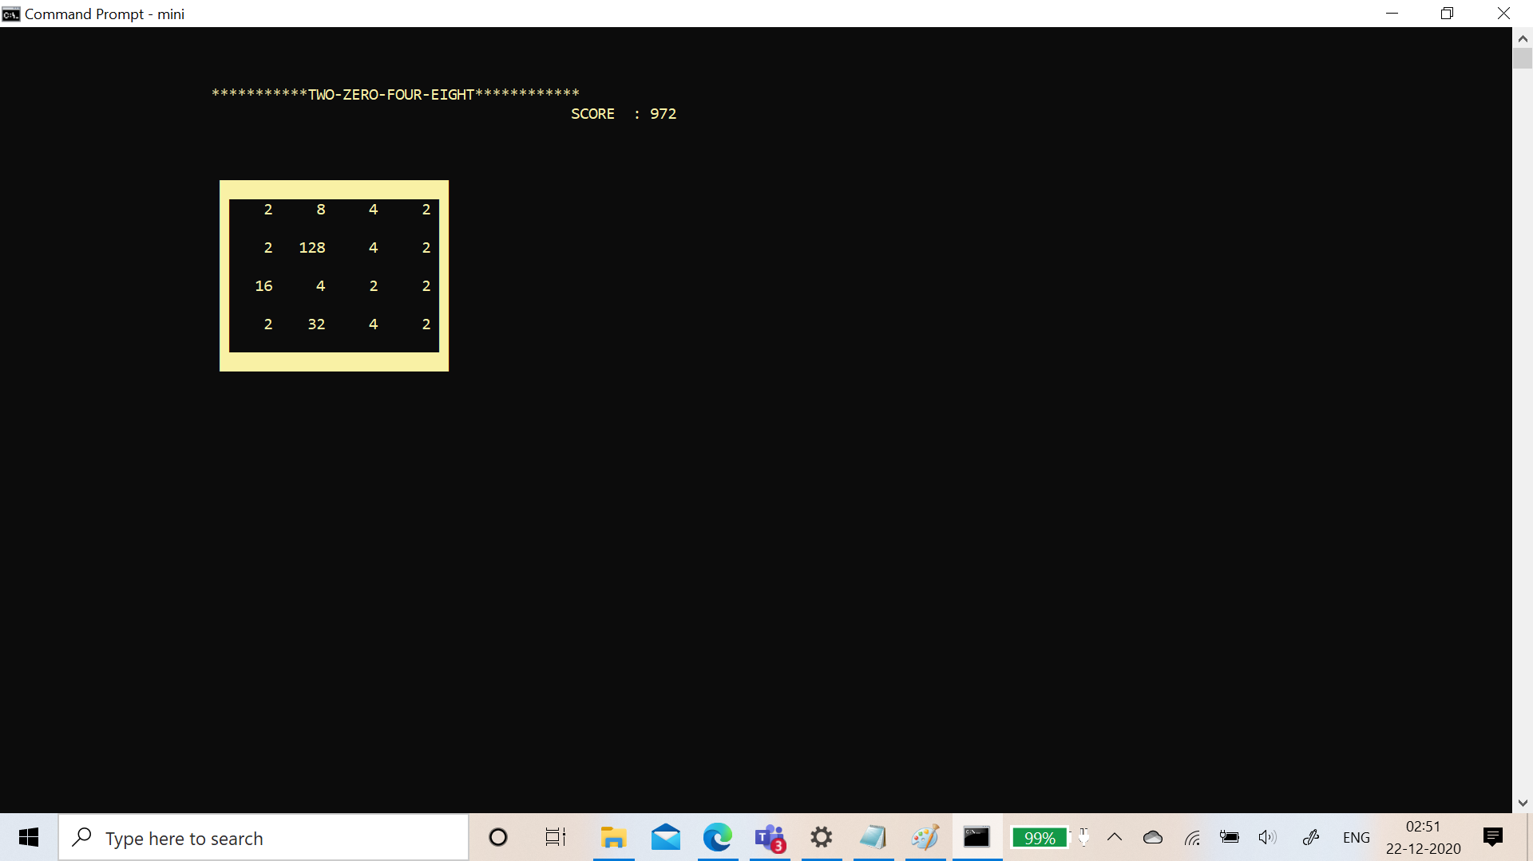

Slide 8
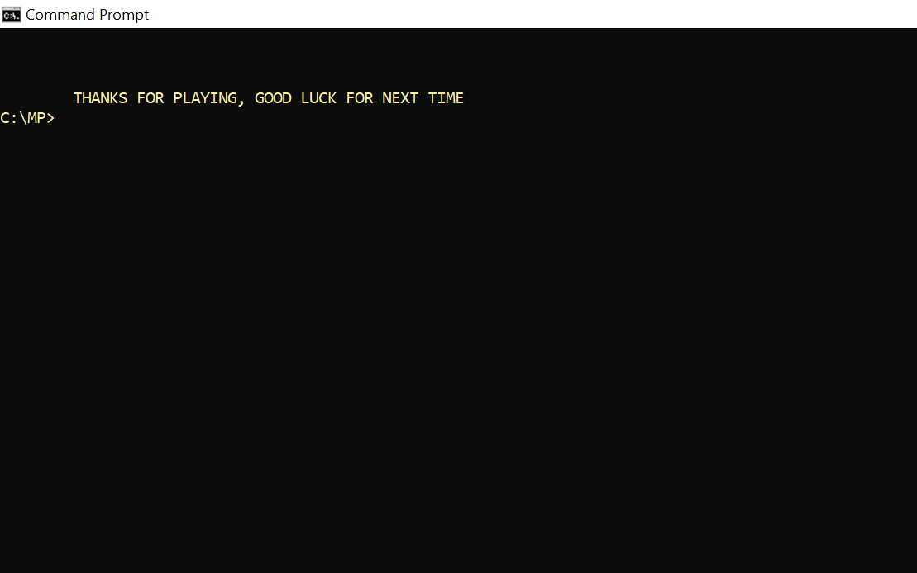

Slide 9
Conclusion and future work
Our future work includes levels like user can select whether he wants to play 3X3 or 3X4 or 4X4 and many more levels.This project can be further improved by converting it into a Web Application using Python and the Django Framework or a Mobile Application using Flutter or React Native.

